Slide 1
Lecture 18: Periodic trends and covalent bonds
California State University, Fullerton
2023 Fall Semester – Chem 123

Slide 2

QUESTIONS, COMMENTS, AND CONCERNS?

Slide 3
Outline
Announcements
Highlights prior lecture
Ch. 8: Electron configuration
Ch. 9: Periodic Trends
Atomic Radius and Ions
Ionization Energy and Electron Affinity
Electronegativity
Ch. 10: Covalent Bonds
Drawing Lewis Structures
Resonance and Formal Charges
Exceptions to the octet rule
Polarity of bond

Slide 4
announcements
Still grading exam 2
Online Ch 8+9 Hw is posted and due Nov 7th at 11:59pm
Chs 8+9 in-class worksheet Mon, Nov 6th due at 11:59pm
Exam 3 coming up Weds, Nov 15th covering Chs 8-10, and part of 11

Slide 5
Outline
Announcements
Highlights prior lecture
Ch. 8: Electron configuration
Ch. 9: Periodic Trends
Atomic Radius and Ions
Ionization Energy and Electron Affinity
Electronegativity
Ch. 10: Covalent Bonds
Drawing Lewis Structures
Resonance and Formal Charges
Exceptions to the octet rule
Polarity of bond

Slide 6
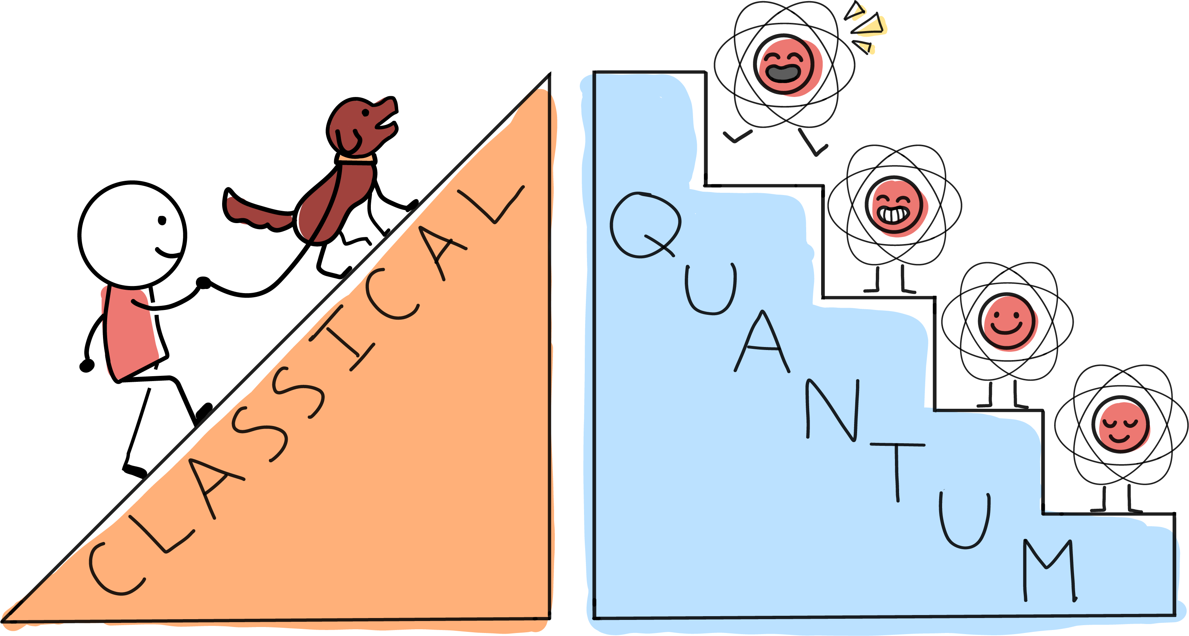
Classical and quantum picture of energy

Slide 7
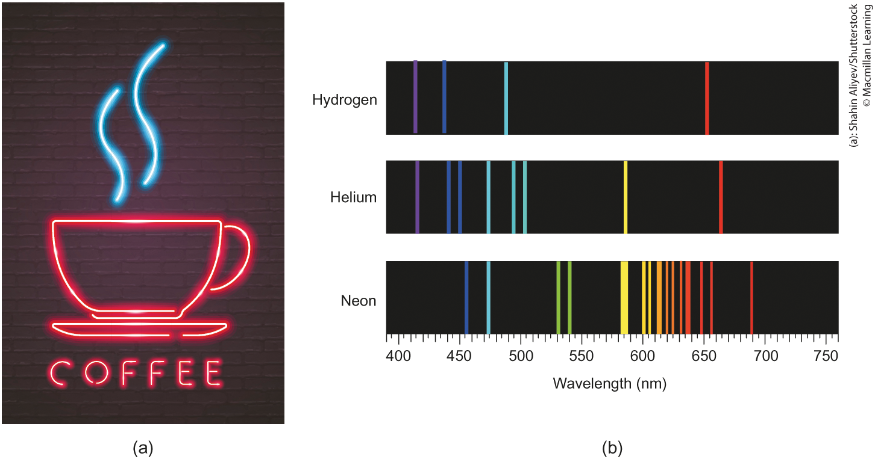
Discrete light emissions
Hydrogen, helium, and neon emits discrete light energy

Slide 8
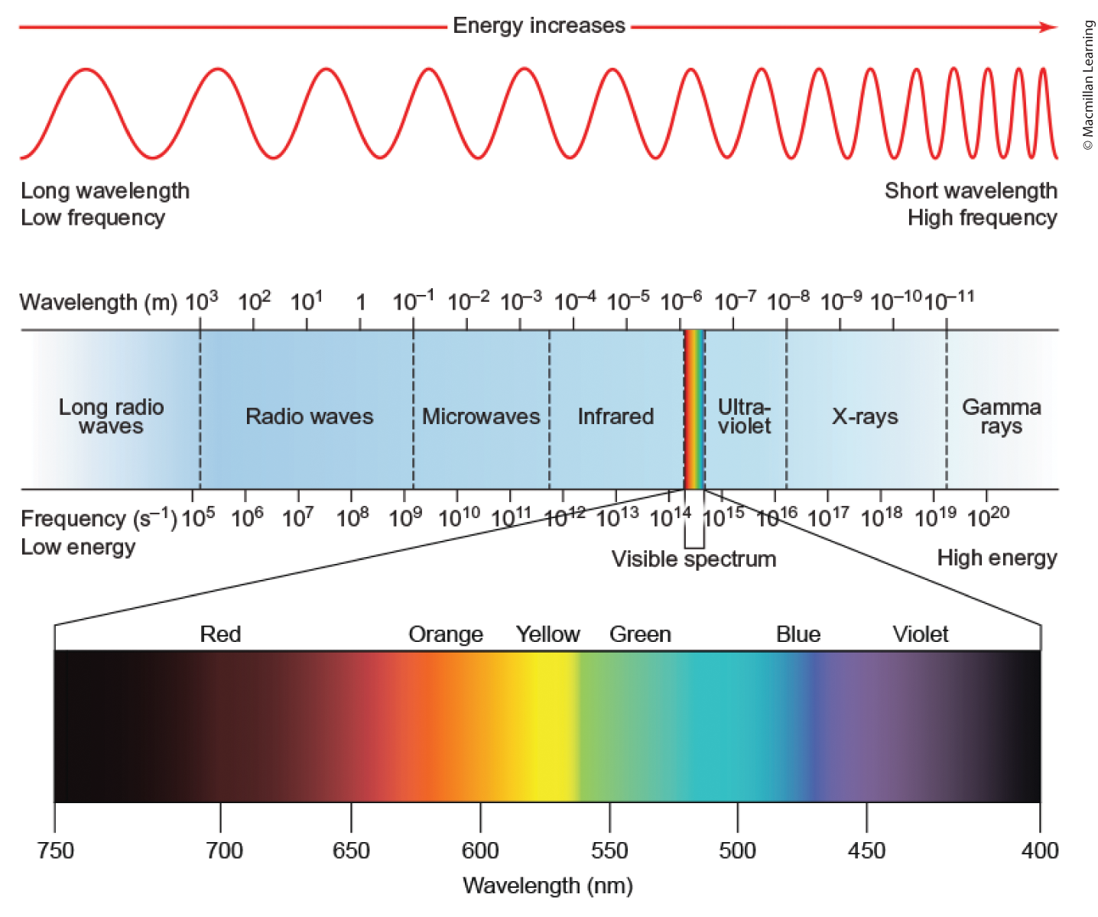
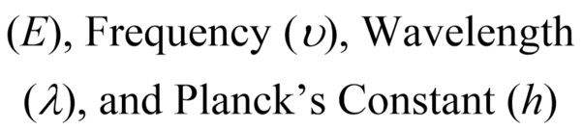
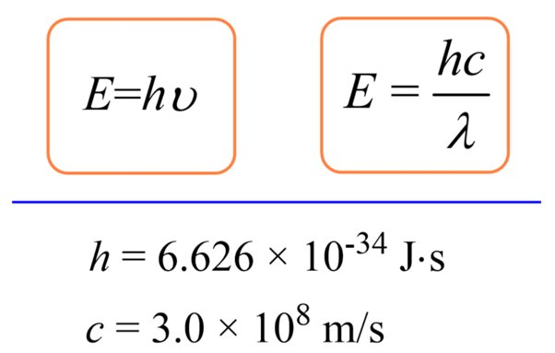
Energy of electromagnetic radiation

Slide 9

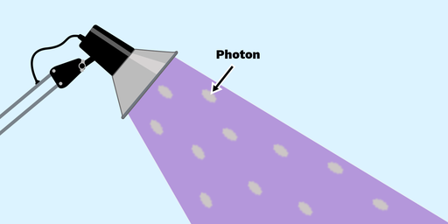
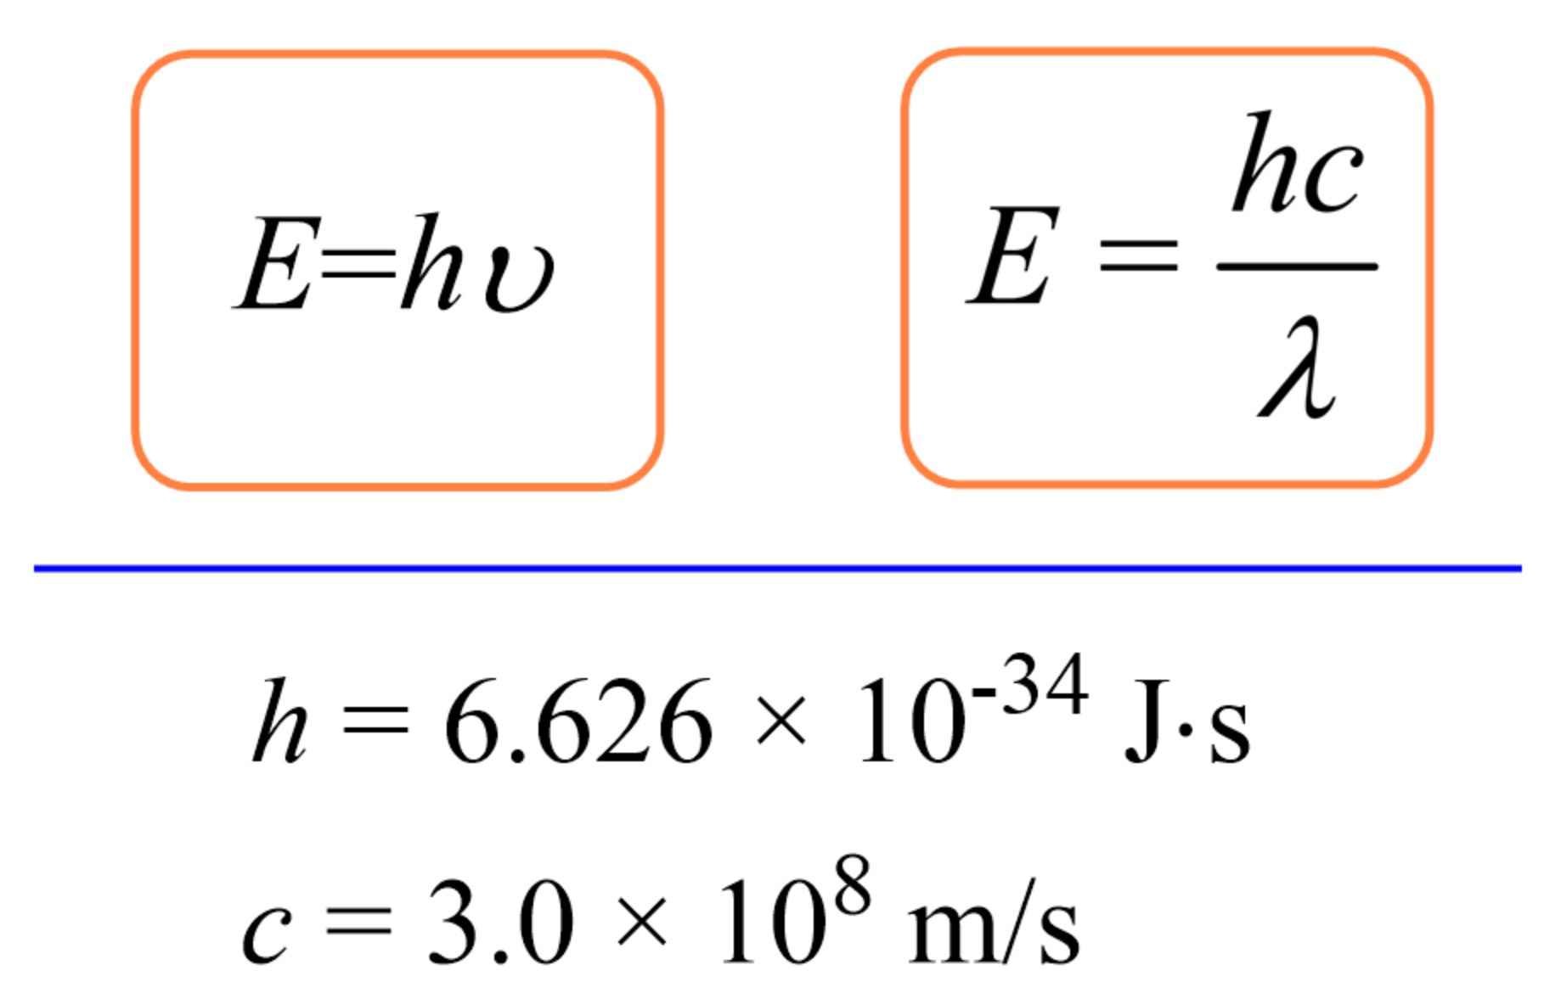
Light energy
Light emits photons (wavepacket of energy)
Each wavepacket contains energy
Formula E=hv gives you the energy of 1 photon (J/photon)
Q: How do I convert the units to J/(mol photon)

Slide 10
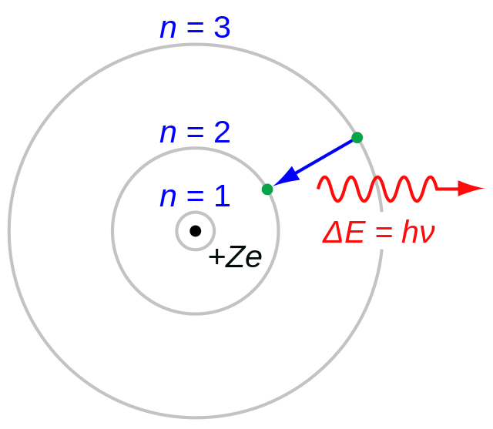
Bohr model of the atom
Singular proton of the hydrogen atom or the protons and neutrons of the hydrogen-like species(He⁺, Li²⁺, etc.)
Electron revolves around fixed circular paths of fixed radius and energy called stationary states
Energy of the electron changes only when it makes transitions from the energy level of one stationary state to the energy level of another stationary state (wavepacket)

Slide 11
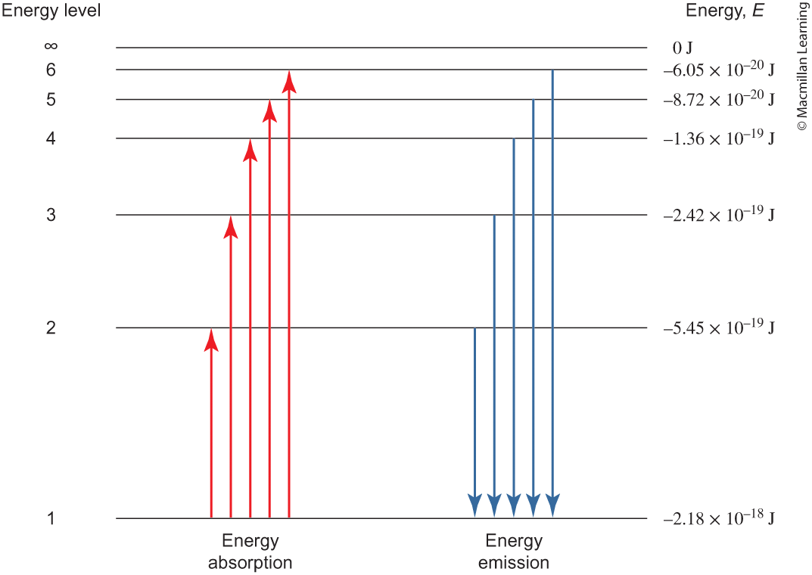
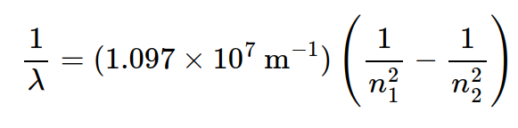
Energy levels and rydberg equation
n is the energy levels
λ is the wavelength (m)

Slide 12
Outline
Announcements
Highlights prior lecture
Ch. 8: Electron configuration
Ch. 9: Periodic Trends
Atomic Radius and Ions
Ionization Energy and Electron Affinity
Electronegativity
Ch. 10: Covalent Bonds
Drawing Lewis Structures
Resonance and Formal Charges
Exceptions to the octet rule
Polarity of bond

Slide 13
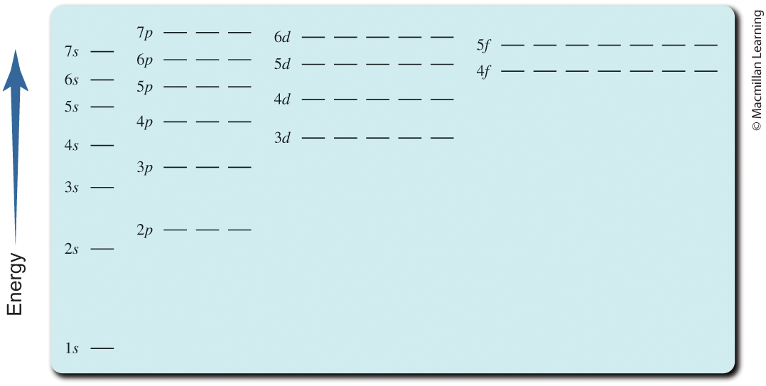
Atomic Orbital diagram

Slide 14
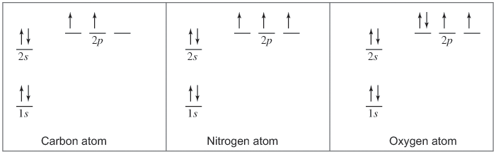
Filling in atomic orbitals with electrons
Aufbau Principle – Electrons in a ground-state atom always fill the lowest-energy position that is available
Hund's Rule – Maximize the total spin of the atom; half-filled and fully-filled atomic orbitals are preferred (lowest energy)

Slide 15
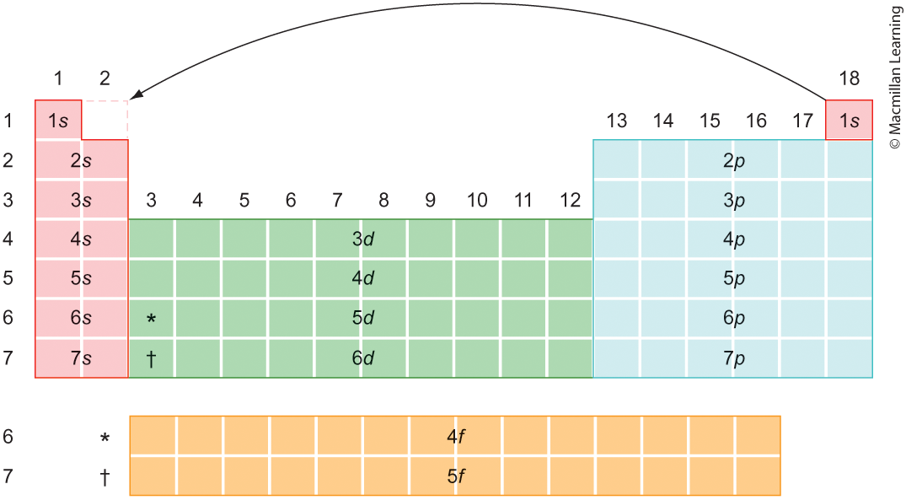
Electron configuration

Slide 16
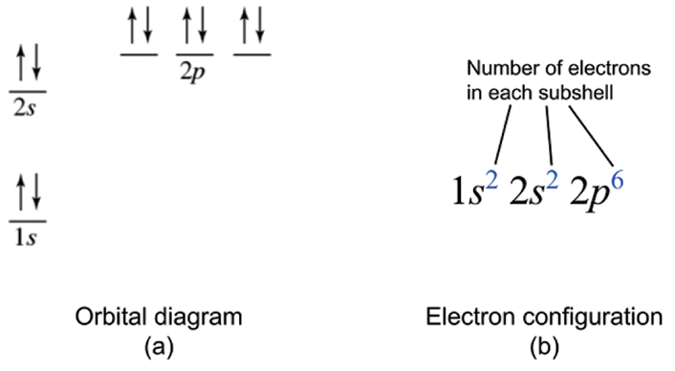
Electron configuration
Shows the arrangement of electrons in order of increasing energy

Slide 17
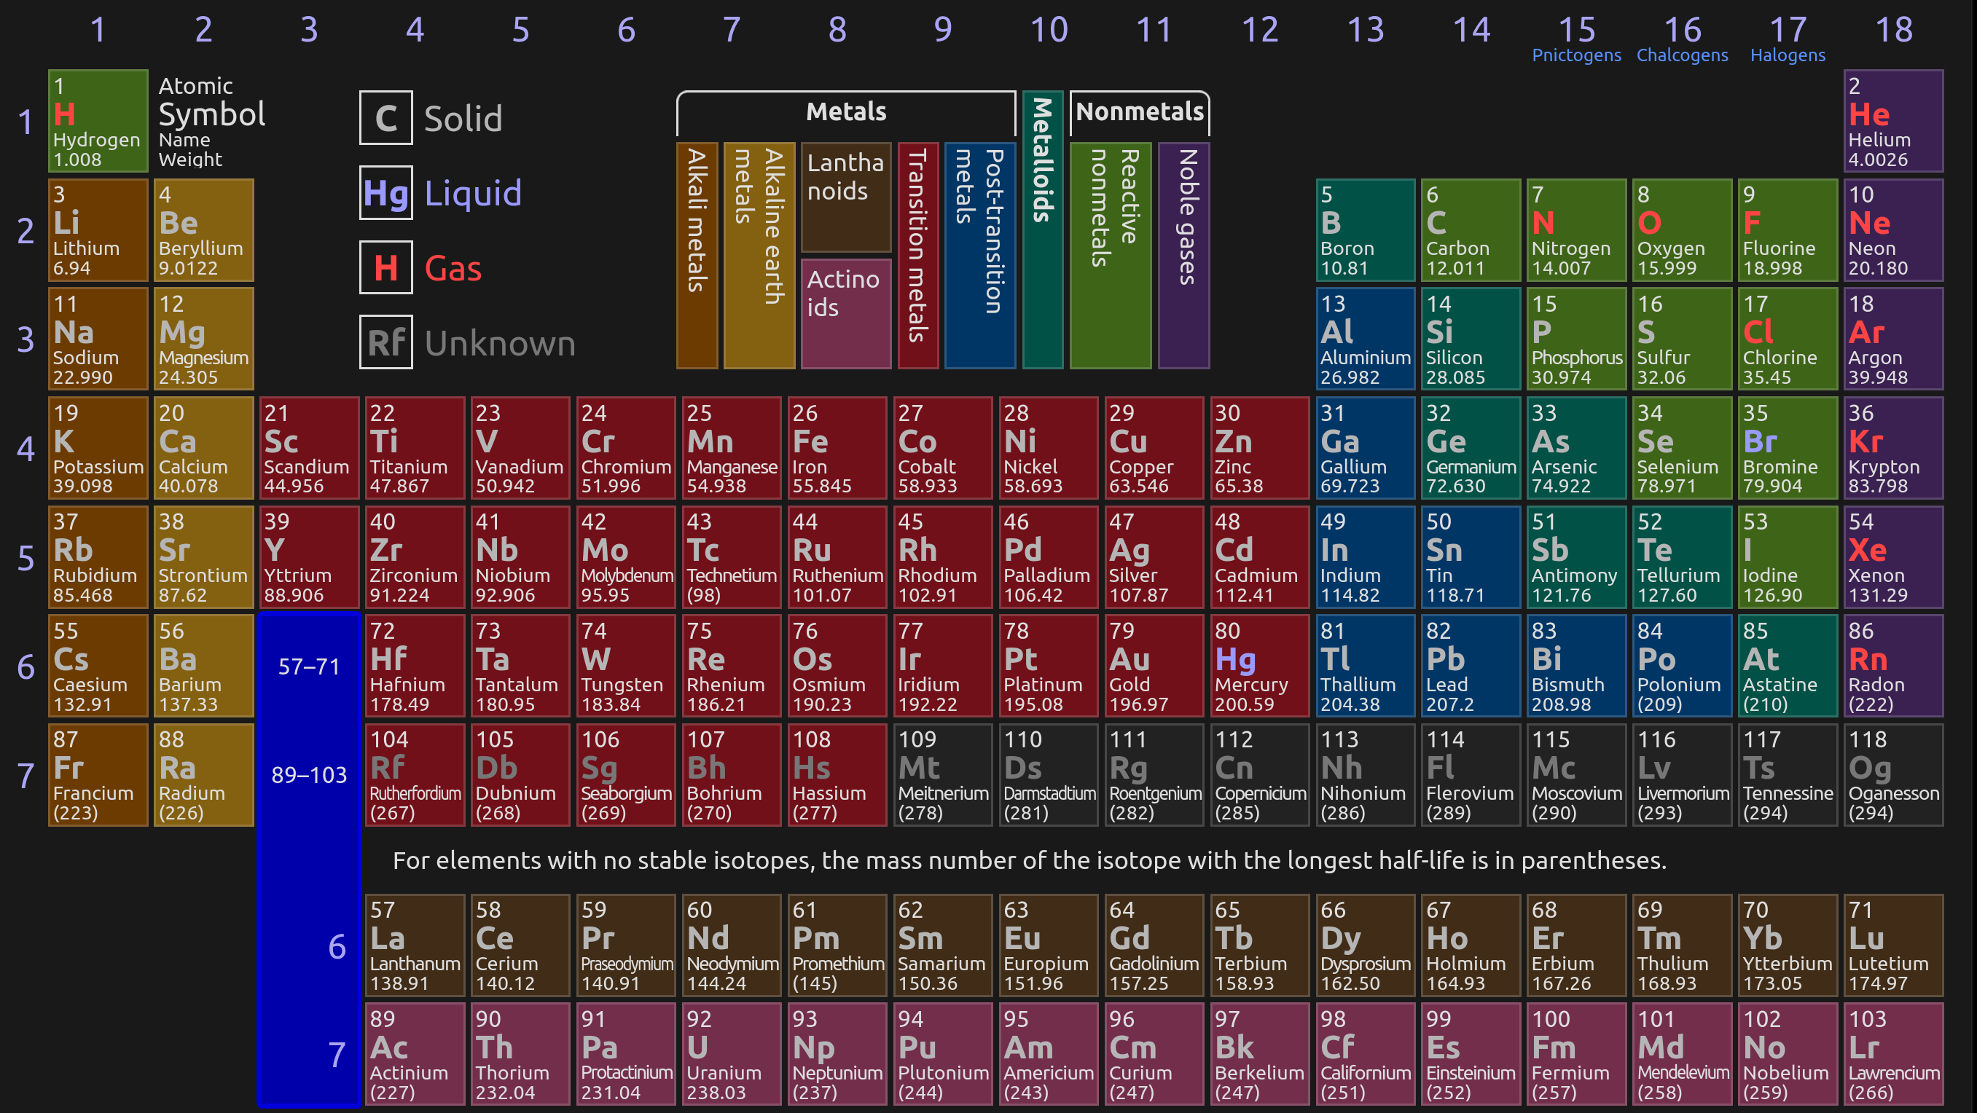
Periodic table – electron configuration

Slide 18
Your turn: determine the electron configuration of the following
He
N
P
Fe
Cr
Cu

Slide 19
Outline
Announcements
Highlights prior lecture
Ch. 8: Electron configuration
Ch. 9: Periodic Trends
Atomic Radius and Ions
Ionization Energy and Electron Affinity
Electronegativity
Ch. 10: Covalent Bonds
Drawing Lewis Structures
Resonance and Formal Charges
Exceptions to the octet rule
Polarity of bond

Slide 20
Core electrons vs valence electrons
Core electrons – inner most electrons in the atom, closest to the nucleus
Valence electrons – outer most electrons in the atom, farthest to the nucleus
Example: Electron configuration of oxygen atom
1s²2s²2p⁴
Core electrons: 1s²
Valance electrons: 2s²2p⁴
Q: Which electrons participate in chemical reactions?

Slide 21
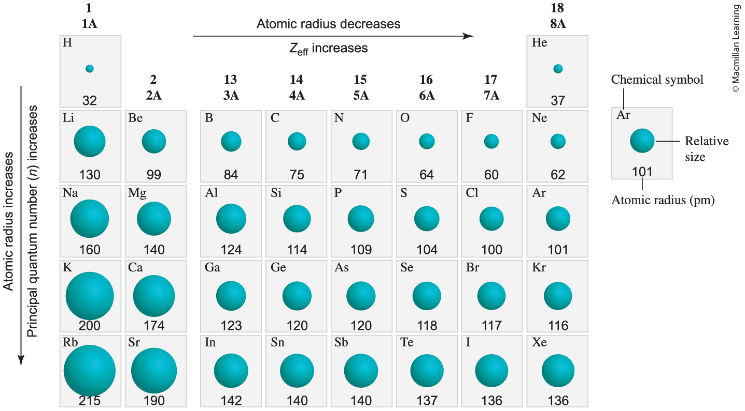
Atomic radius
Size of atom depends on electronic structure – the interactions between the nucleus and electrons

Slide 22
Q: WHy is the atomic radius decreasing from left to right?

Slide 23
Q: Why is the atomic radius increasing from top to bottom?

Slide 24
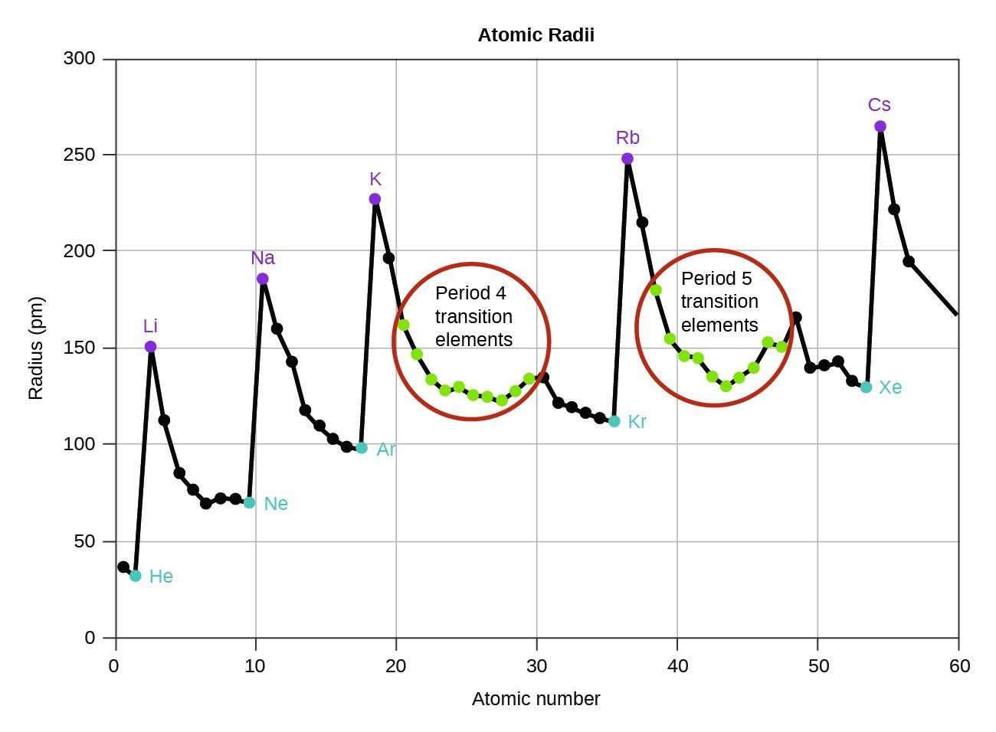
Atomic radius of transition metals
d block contraction and poor electronic screening from d orbitals

Slide 25
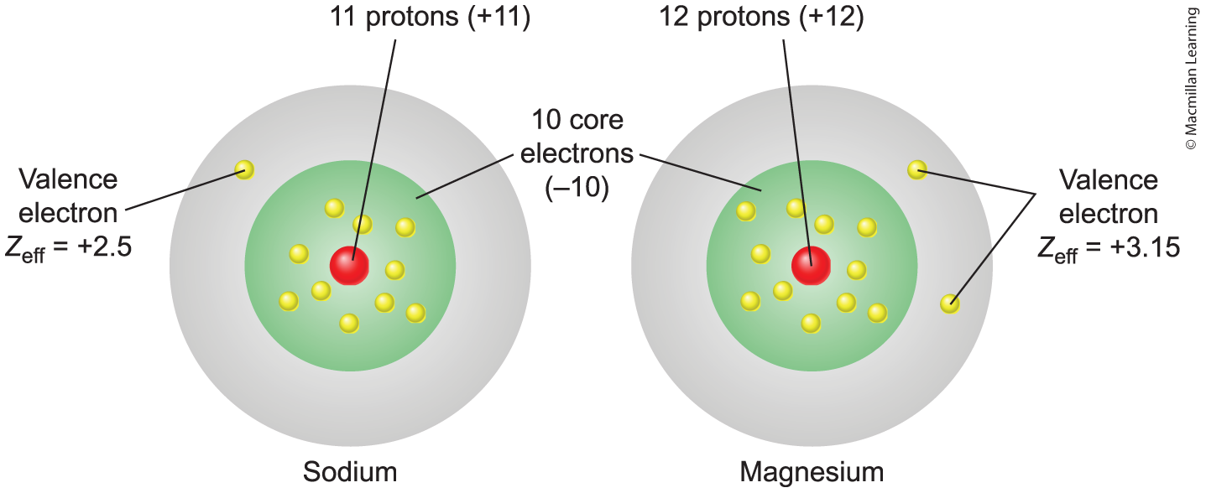
Effective nuclear charge (Z_{eff})
Actual amount of positive (nuclear) charge experienced by an electron in a multi-electron atom

Slide 26
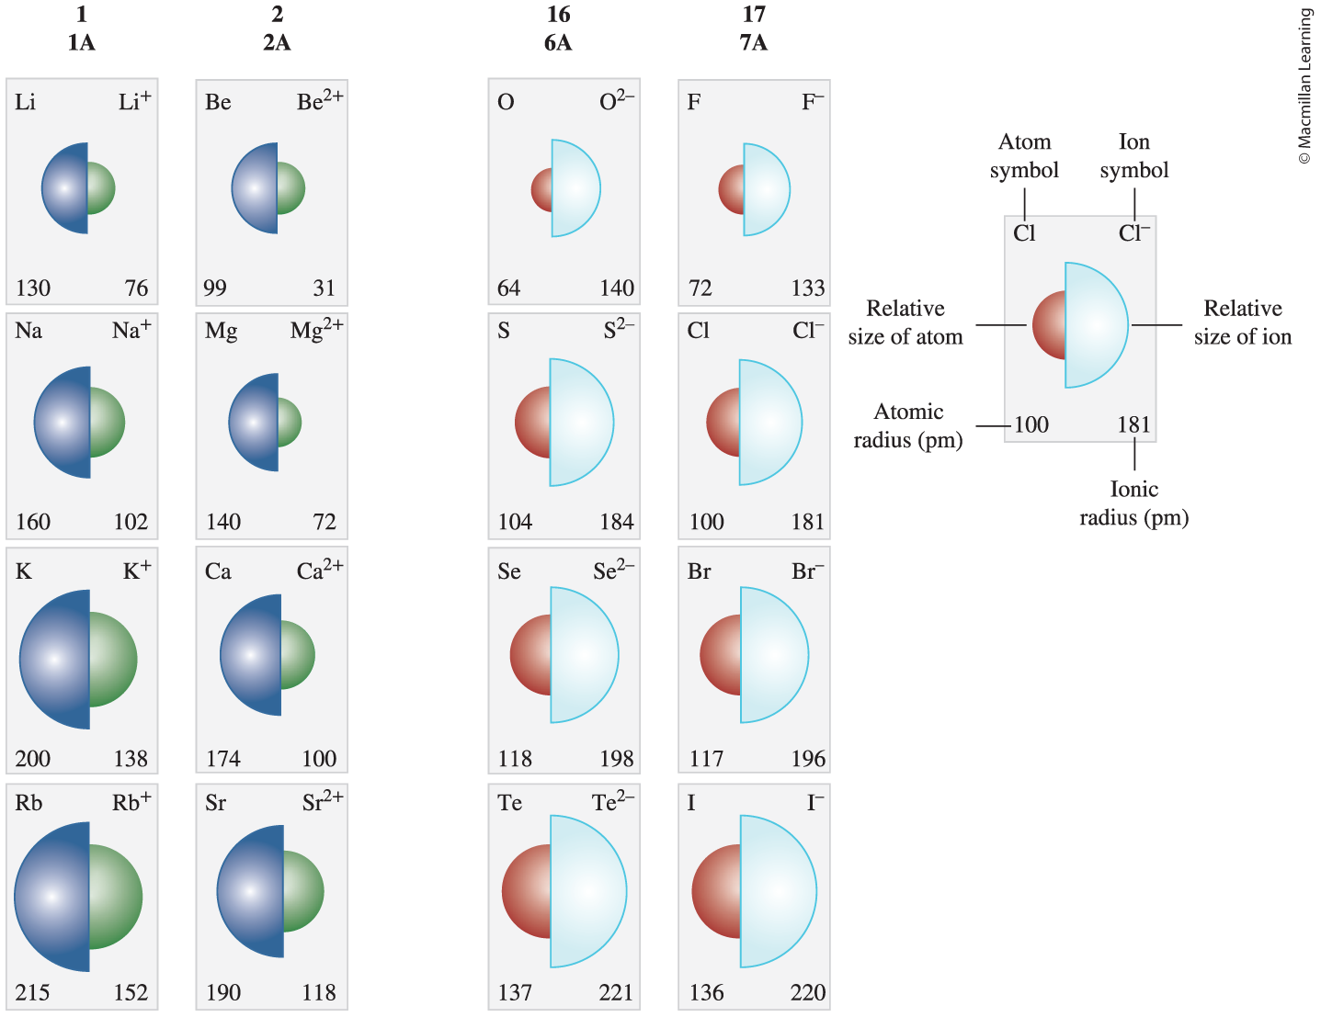
Ionic radius

Slide 27
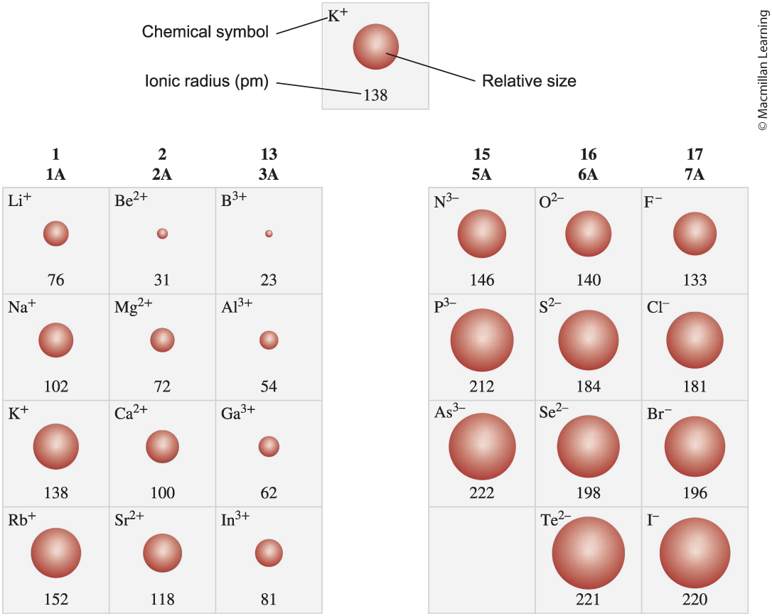
Ionic radius

Slide 28
Outline
Announcements
Highlights prior lecture
Ch. 8: Electron configuration
Ch. 9: Periodic Trends
Atomic Radius and Ions
Ionization Energy and Electron Affinity
Electronegativity
Ch. 10: Covalent Bonds
Drawing Lewis Structures
Resonance and Formal Charges
Exceptions to the octet rule
Polarity of bond

Slide 29
Ionization energy and electron affinity
Ionization energy – amount of energy to remove an electron from an atom
Electron affinity – energy difference when electron is added to an atom

Slide 30
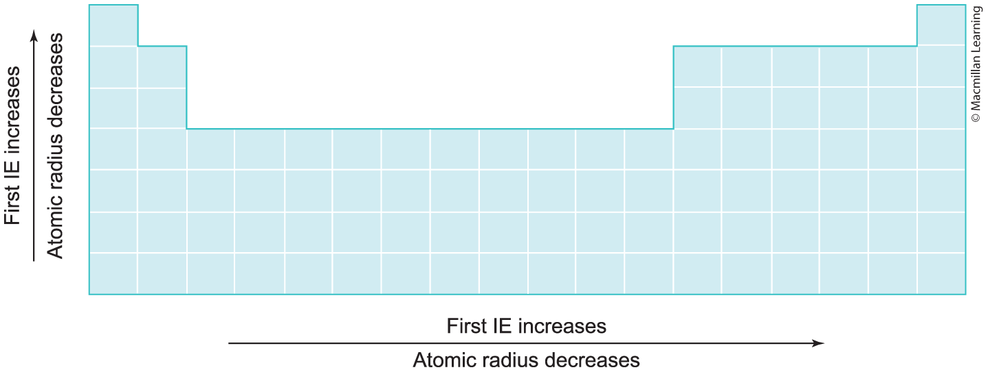
Ionization energy
Q: Why does IE increase from left to right? Bottom to top?

Slide 31
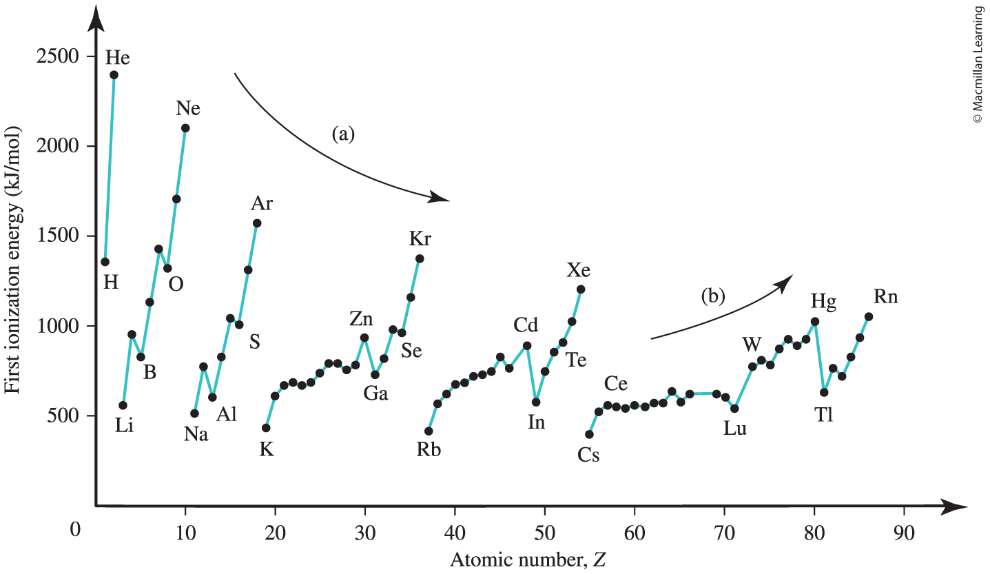
First ionization energy trend

Slide 32
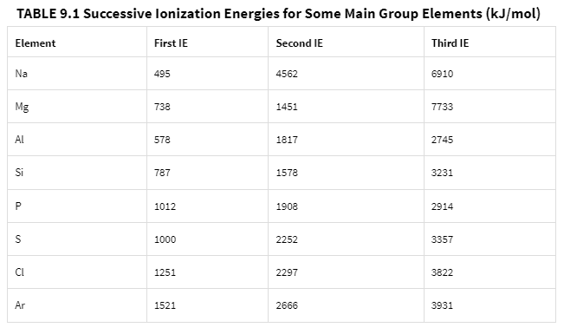
Multiple ionization energy

Slide 33
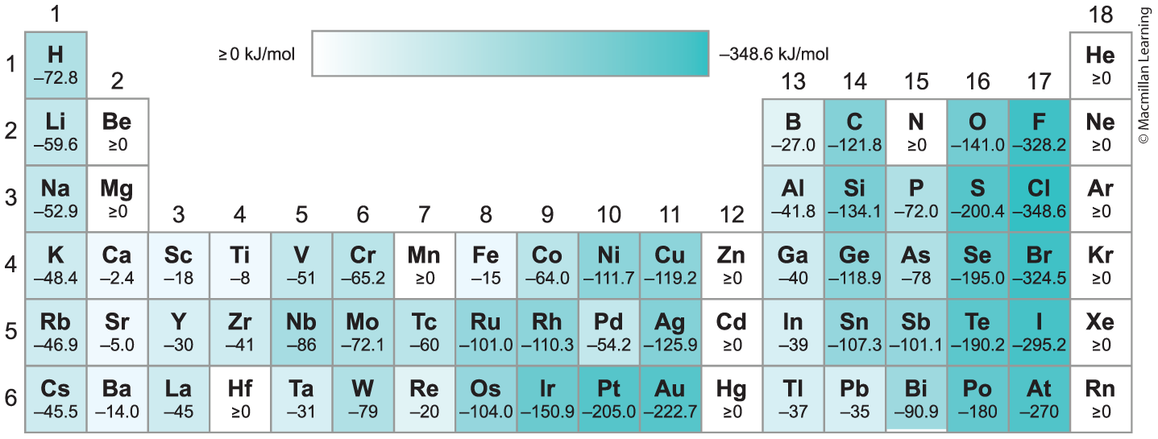
Electron affinity
Electron affinity increases from the left to right (due to electronegativity)

Slide 34
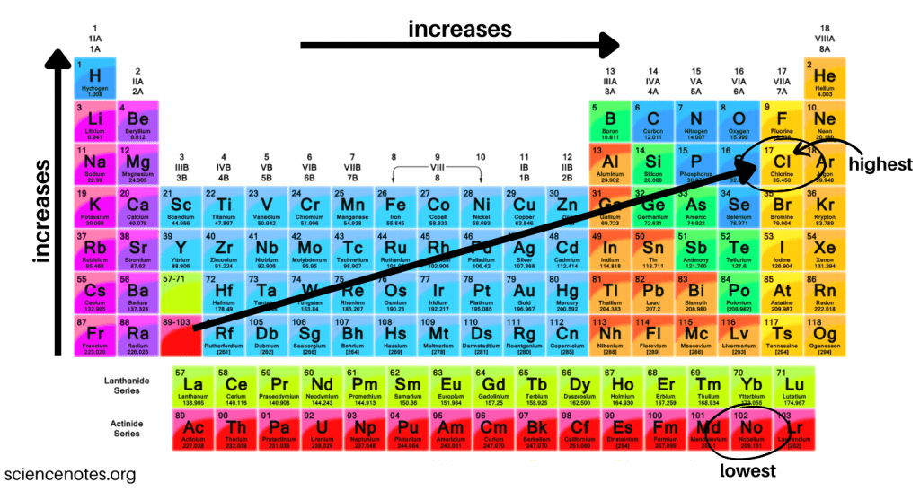
Electron affinity
Q: Why does fluorine have a lower electron affinity than chlorine?

Slide 35
Outline
Announcements
Highlights prior lecture
Ch. 8: Electron configuration
Ch. 9: Periodic Trends
Atomic Radius and Ions
Ionization Energy and Electron Affinity
Electronegativity
Ch. 10: Covalent Bonds
Drawing Lewis Structures
Resonance and Formal Charges
Exceptions to the octet rule
Polarity of bond

Slide 36
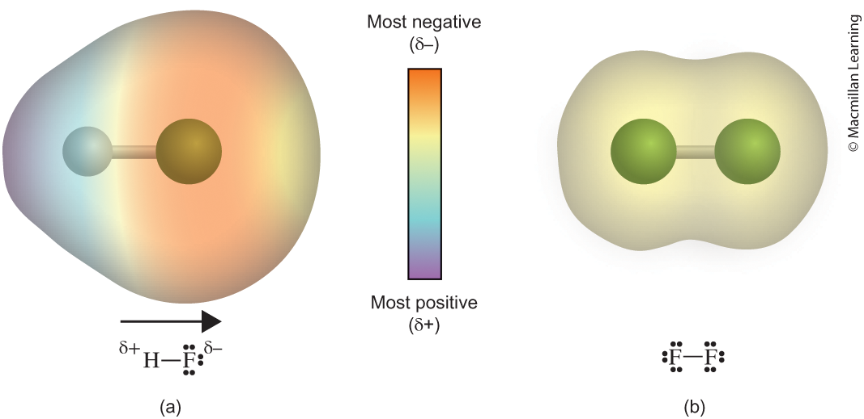
What is electronegativity?
Tendency of an atom to attract electrons toward itself

Slide 37
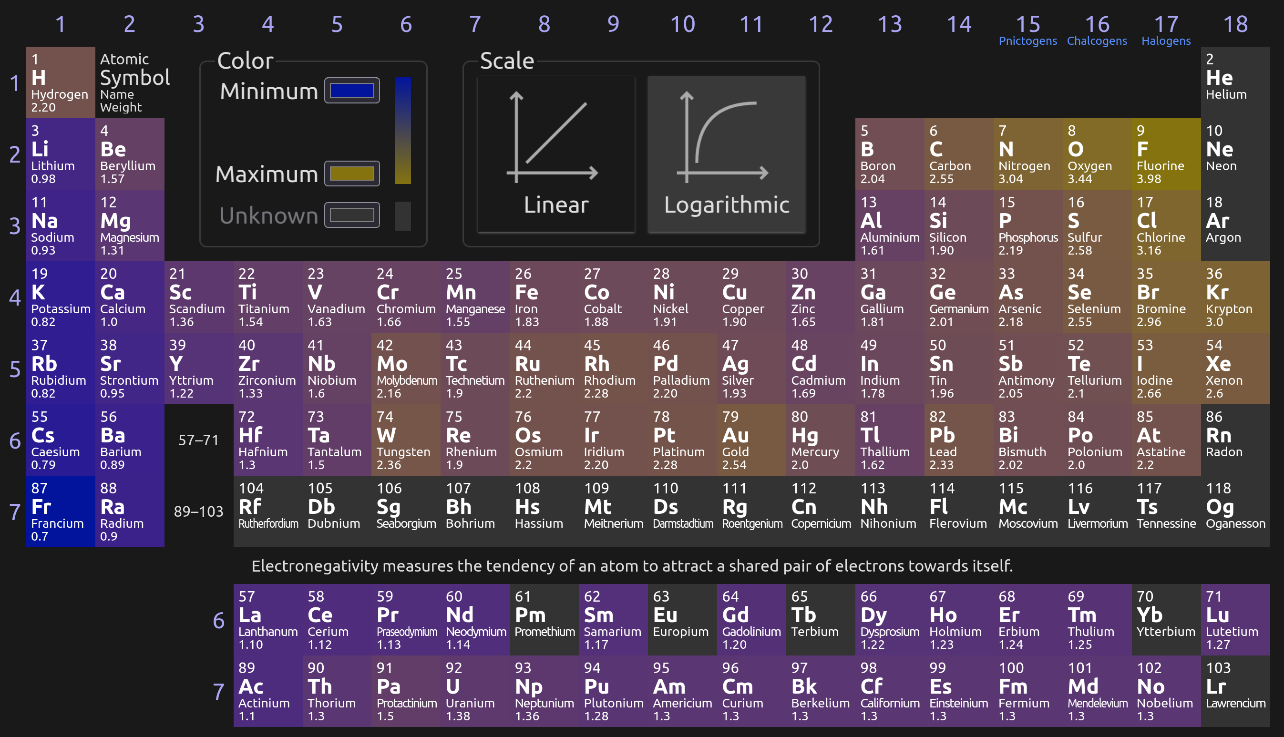
"Quantifying" Electronegativity
Q: Is electronegativity a qualitative or quantitative observation?

Slide 38
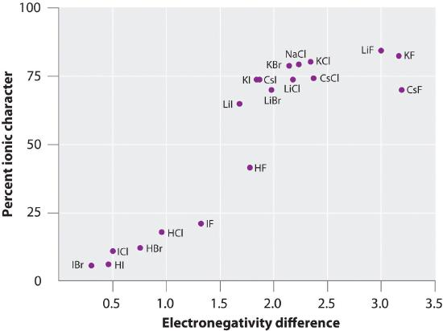
electronegativity
Function of ionization energy and electron affinity
Ionization energy – likelihood of losing electrons
Electron affinity – likelihood of gaining electrons

Slide 39
Outline
Announcements
Highlights prior lecture
Ch. 8: Electron configuration
Ch. 9: Periodic Trends
Atomic Radius and Ions
Ionization Energy and Electron Affinity
Electronegativity
Ch. 10: Covalent Bonds
Drawing Lewis Structures
Resonance and Formal Charges
Exceptions to the octet rule
Polarity of bond

Slide 40
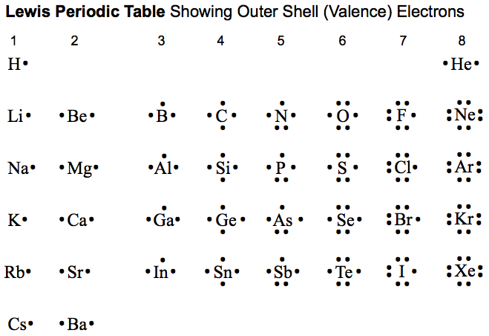
Covalent bonds
Sharing of valence electrons between two atoms

Slide 41
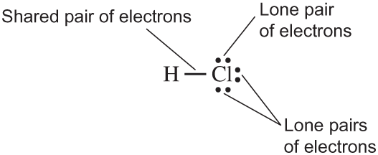
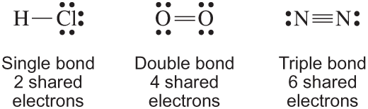
General features Lewis structure
Satisfying the octet rule (8 electrons surrounding the atom) but there are exceptions
Each bond is two electrons shared between atoms (localized)
Lone pairs are not shared between atoms (delocalized)
Strength of bonds: Single < Double < Triple

Slide 42
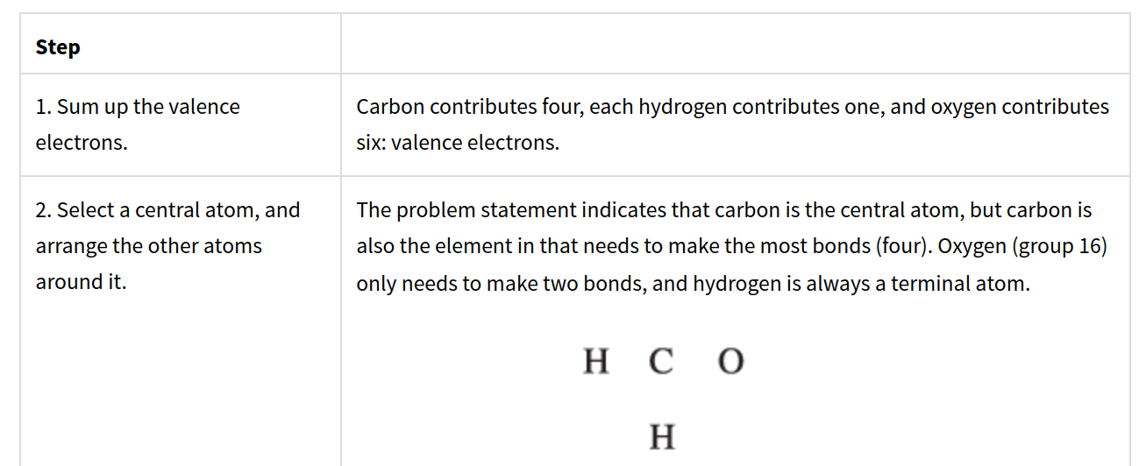
Steps to drawing lewis structures: CH₂O

Slide 43
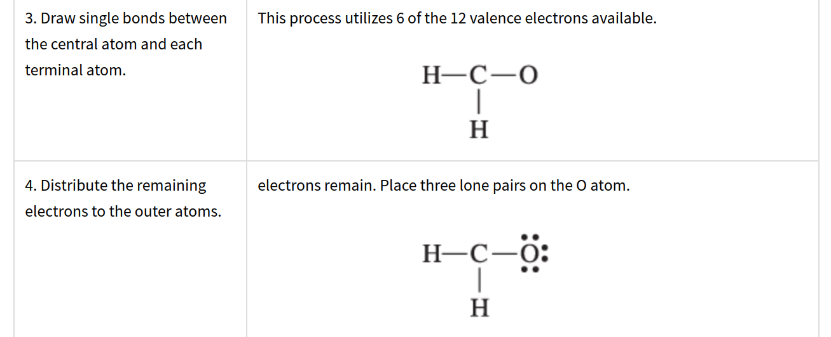
Steps to drawing lewis structures

Slide 44
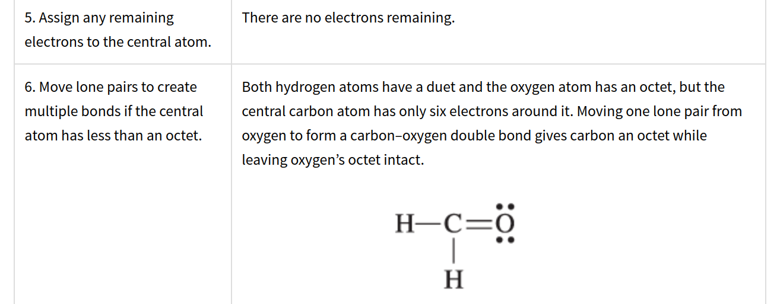
Steps to drawing lewis structures

Slide 45
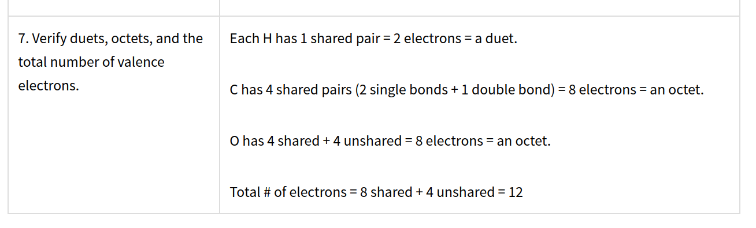
Steps to drawing lewis structures

Slide 46
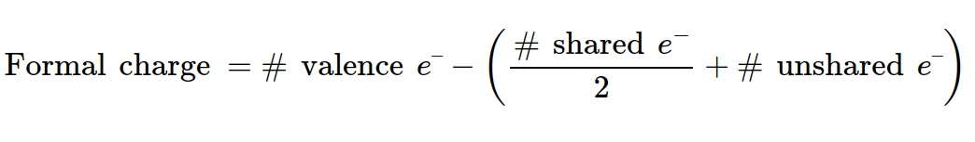
Final check: calculating formal charges
The charge assigned to an atom in a molecule, assuming that electrons in all chemical bonds are shared equally between atoms

